Slide 1

At-Risk Detection using LMS Behavior
By: Jamie Loewen
Notes:
Good afternoon everyone. I’m Jamie Loewen and my Data Science project is a predictive model that detects whether a college student is at-risk or not based on their Learning Management System behavior.

Slide 2



Motivation
Increase retention rates at the College
Identify at-risk students in order to intervene and assist in helping them achieve graduation goals.
At-Risk
Intervention
Notes:
The motivation of this project is to increase retention rates by identifying at-risk students as early as possible, intervene, and provide them with the assistance they need to help them achieve their graduation goals.

Slide 3

Motivation
Learning Management System (LMS) data is collected, but currently unused by the College.
Is there any connection between a students’ LMS behavior and their final grade?
A
?
B-
D+
F
Notes:
When I was informed that the College I work at collects LMS data, but doesn’t utilize it, I figured this was a perfect opportunity to see if this data had any sort of connection to a student’s academic trajectory.

Slide 4
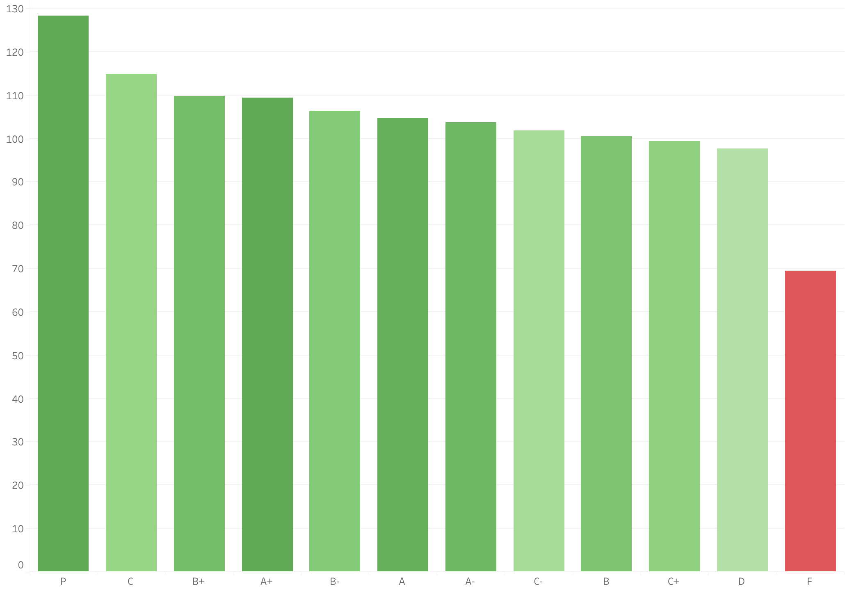
Average Logins Per Course
At-Risk
Grade
Notes:
It turned out that there was a connection. I’ll show a couple of examples of this, the first of which being the connection between the number of logins a student has per course and their grade. We can see clearly that students who are at-risk (ie have a failing grade) have substantially fewer logins per course on average than those students who have a passing grade.

Slide 5
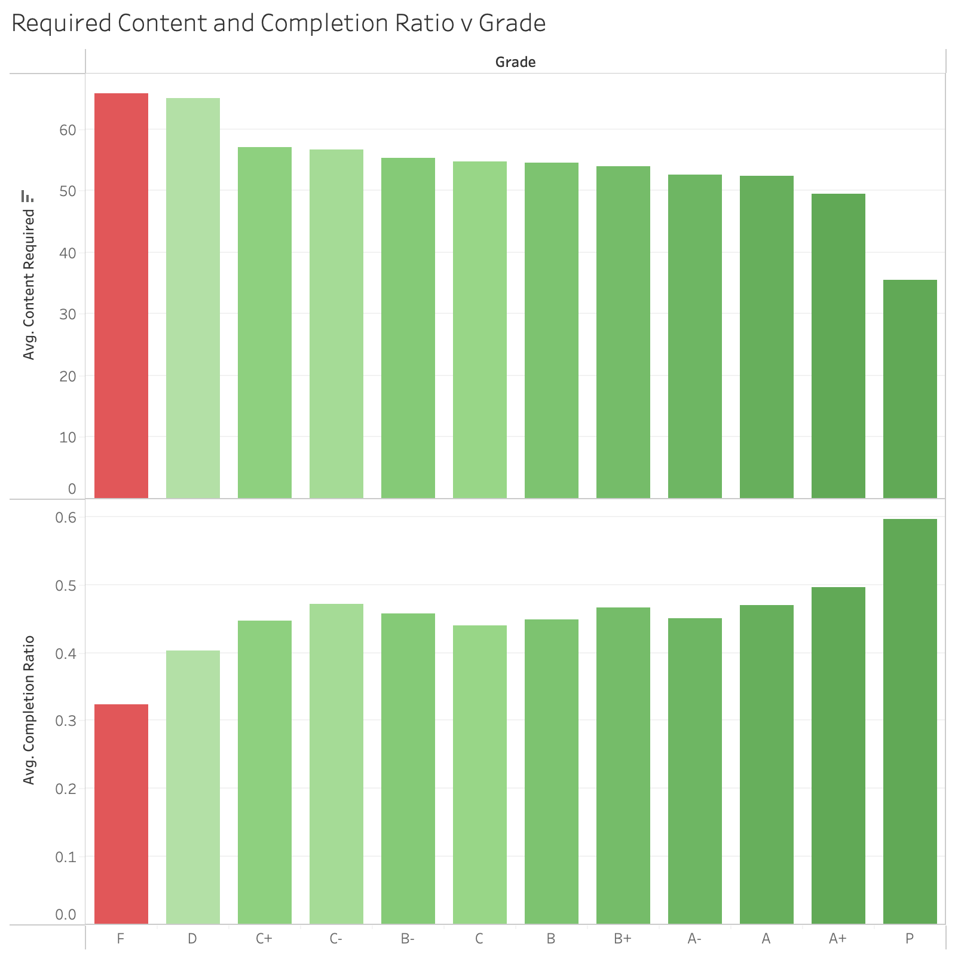
Content Completion Ratio
At-Risk
Grade
Notes:
The content completion ratio (that is, how percentage of content a student has completed) also has a direct relationship with a student's grade. In other words, the less material a student completes, the worse they do.

Slide 6
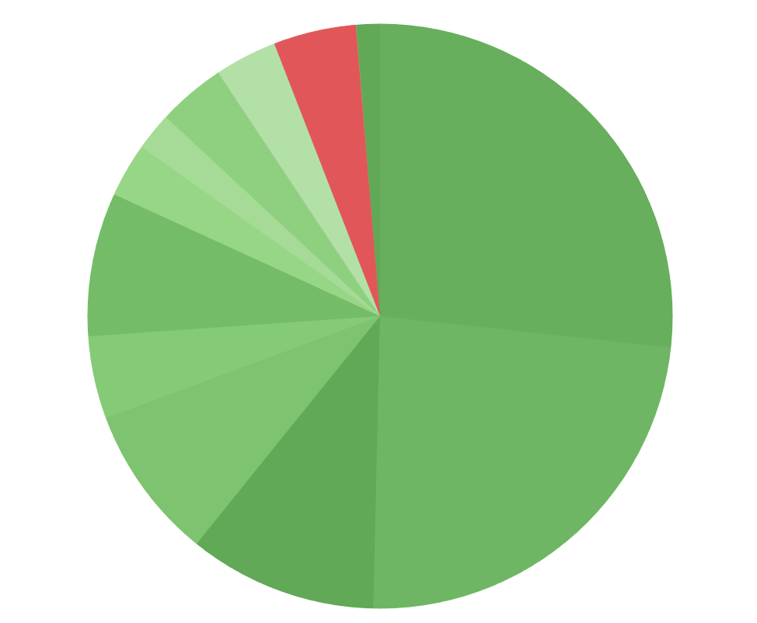
Modeling
Dataset comprises of ~7000 student records.
Content Required/Content Completed
Total System logins
Time spent in content
Course code
Age, etc.
Binary Classification Approach
A – D → Not At-Risk
F → At-Risk
At-Risk
~4.5%
Notes:
After much EDA, cleaning and processing, the dataset ended up with about 7000 student records, containing student behaviors/characteristics such as content required vs content completed, total system logins, how much time was spent in content, course code, age, etc.
I decided to take a binary classification approach where students are identified as not at-risk if their grade is a passing grade (A - D) and at-risk if they have a failing grade.
However, due to this classification decision, it left me with a substantially imbalanced dataset, with only about 4.5% of students in the at-risk class.

Slide 7
Modeling
Confusion Matrix
TP
FP
“Sacrifice”
Students incorrectly labelled At-Risk
FN
TN
Maximize
Students correctly labelled At-Risk
Notes:
Due to the nature of this data, it was especially important that the recall score on the under-represented class was maximized when evaluating the models – That is, I want to make sure as many at-risk students are correctly classified as possible. This can, however, come at the cost of having some students incorrectly labelled as at-risk that should not be (FPs). But this is an acceptable sacrifice if more at-risk students can be identified.

Slide 8
Final Model: Voting Classifier
Naïve Bayes
Neural Network
XGBoost
Random Forest
713
609
1308
14
1299
23
1321
1
Voting
Classifier
11
65
30
46
17
59
48
28
Weight 1
Weight 2
Weight 3
Weight 4
Prediction
Notes:
When training and evaluating multiple different classification models I noticed that some of them had varying strengths and weaknesses. More particularly, some had far better recall scores while some had better FP rates. Overall, I noticed these two metrics had somewhat of an inverse relationship with one another.
So this led me to believe that maybe I could combine these strengths and weaknesses into a meta model that could balance these metrics well. Ultimately, I ended up using a Voting Classifier, which assigns weights to the results of multiple classifiers, combining these individual predictions into an overall/final prediction.

Slide 9
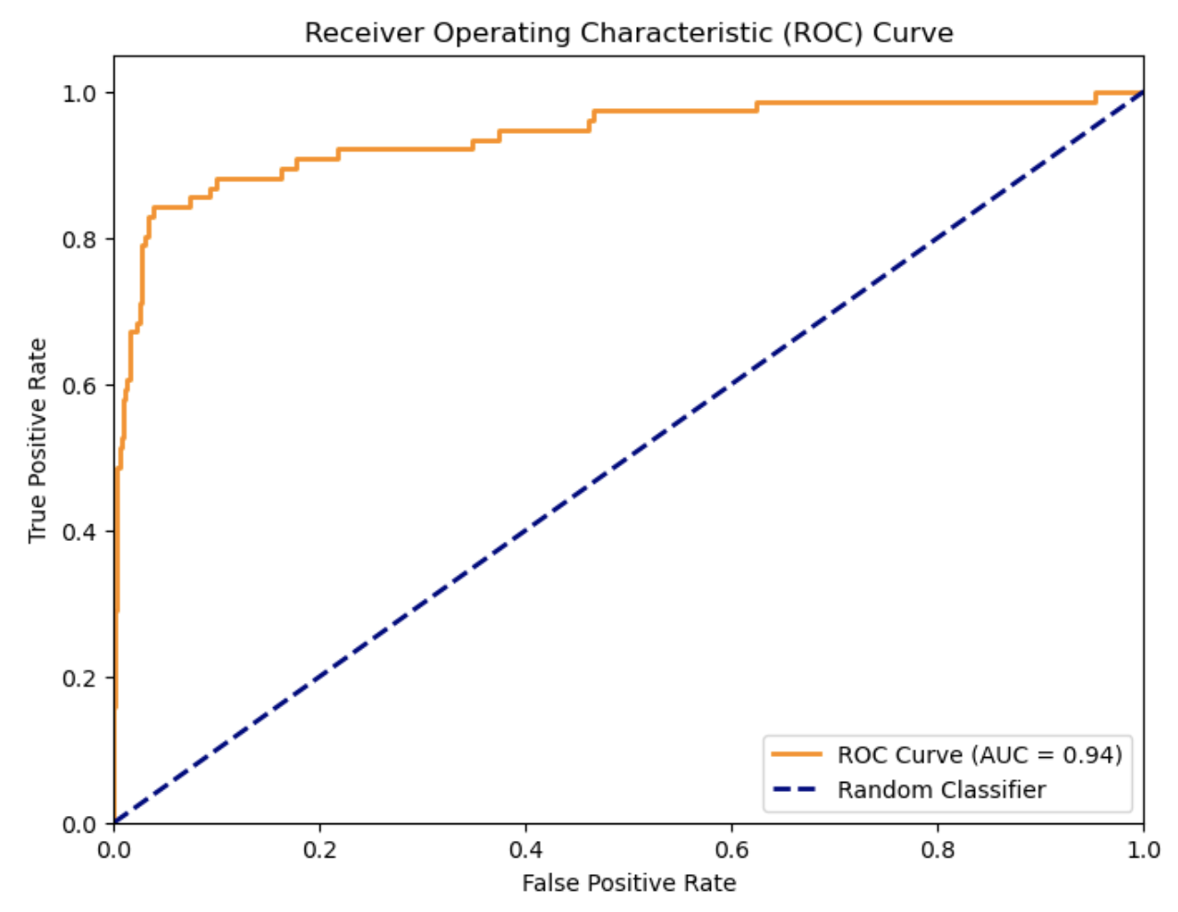
Results
Naïve Bayes
Neural Network
XGBoost
Random Forest
713
609
1308
14
1299
23
1321
1
Voting
Classifier
11
65
30
46
17
59
48
28
2
0
3
0
1264
58
Reasonable FP rate
ROC AUC = 0.94
12
64
Recall = 84%
Notes:
As it turns out, the winning combination was a weight of 2 for Naive Bayes and a weight of 3 for XGBoost.
This gave me a good AUC score and a recall score of 84% on the at-risk class, while also minimizing on False positives to a "reasonable level”.

Slide 10
API Demo!

Slide 11
Conclusions
Overall, an 84% recall on the under-represented class is quite good.
Currently no system such as this currently in place. Something is better than nothing.
If we can help even a few more students who are At-Risk, it’s a win.
Notes:
In conclusion, an 84% recall on the under-represented class is good, especially when you consider that there is no system currently in place collecting and utilizing this LMS data for this purpose. At the end of the day, the more at-risk students we can help, the better.

Slide 12
Next Steps
Create a more user-friendly UI for Student Success Navigators – offering a snapshot of areas the student can improve within LMS.
More data for a better model – NOM NOM NOM!
Notes:
Moving forward, if the school were to implement this, I would want to make a more user-friendly UI that the Student Success Navigators could use as a tool - this would provide them with a snapshot of where the student is at, and also offering suggestions of where the student can improve in their LMS behavior/engagement.
I'd also like to continue my quest to create an even better model by collecting and using more LMS data.

Slide 13


Thank You!
Congratulations to my cohort for making it through.
Thank you to all of the Teachers, Mentors, Support Staff at LHL.
Notes:
Thanks for listening. It's been a real slice folks :)

